Slide 1
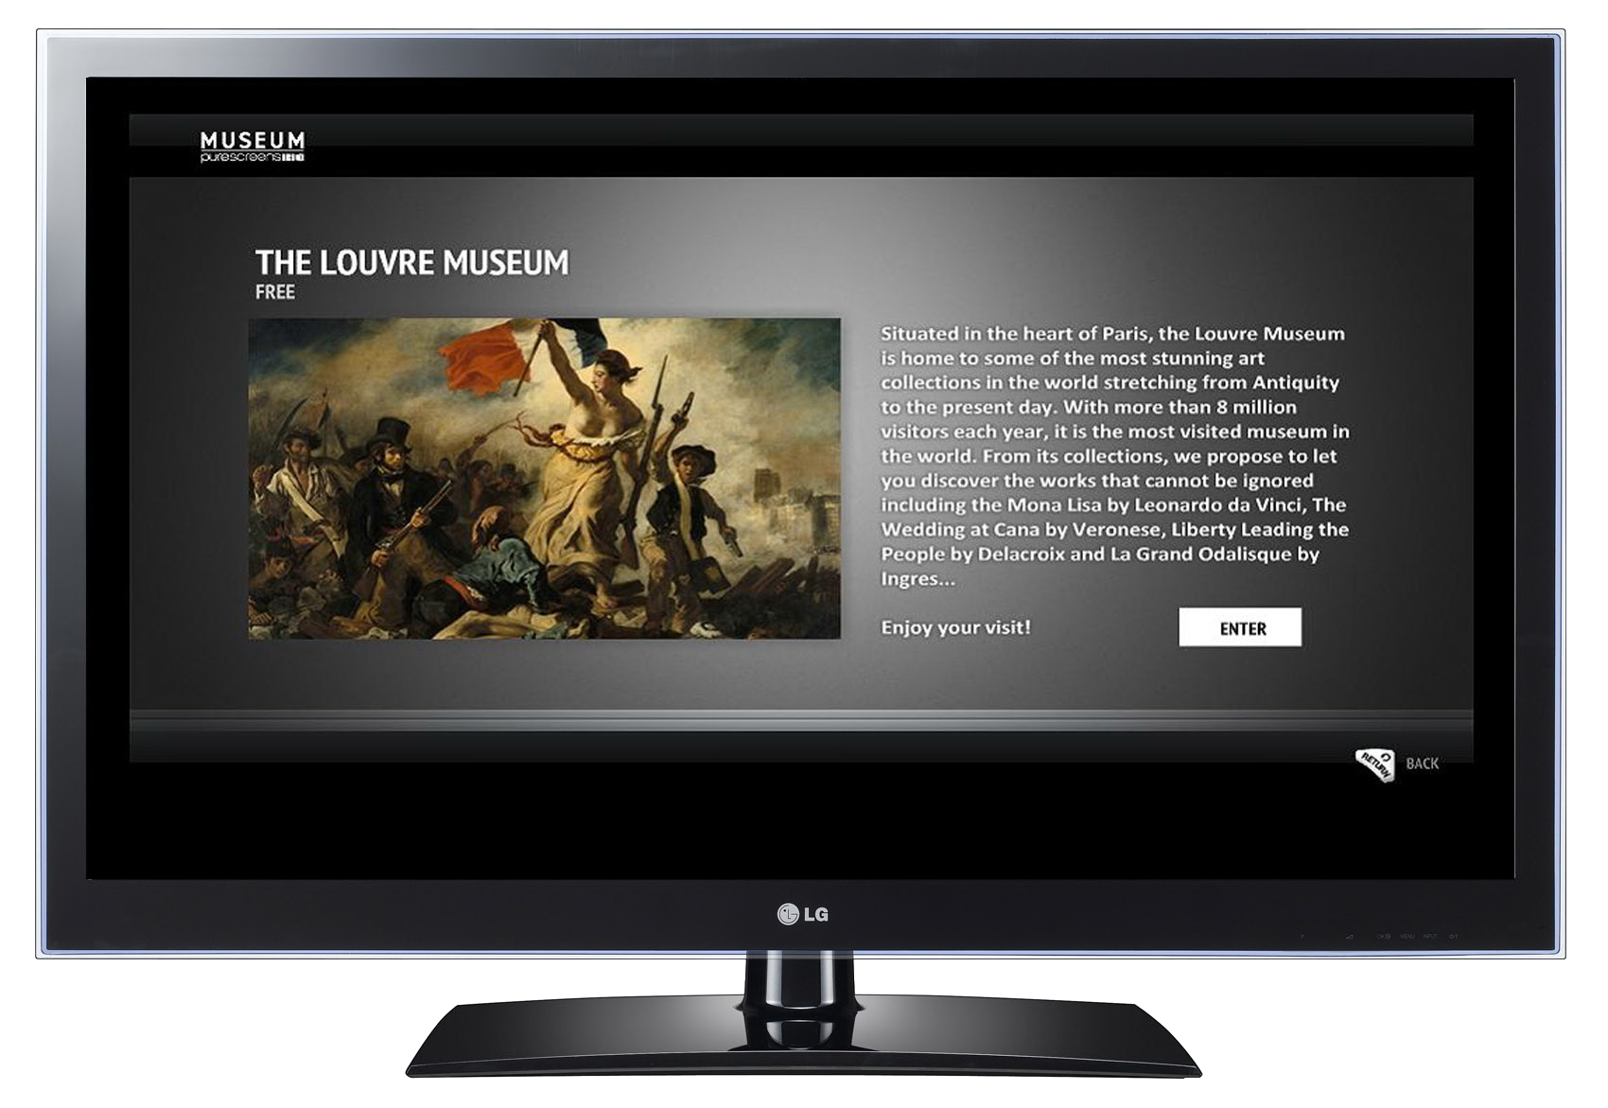
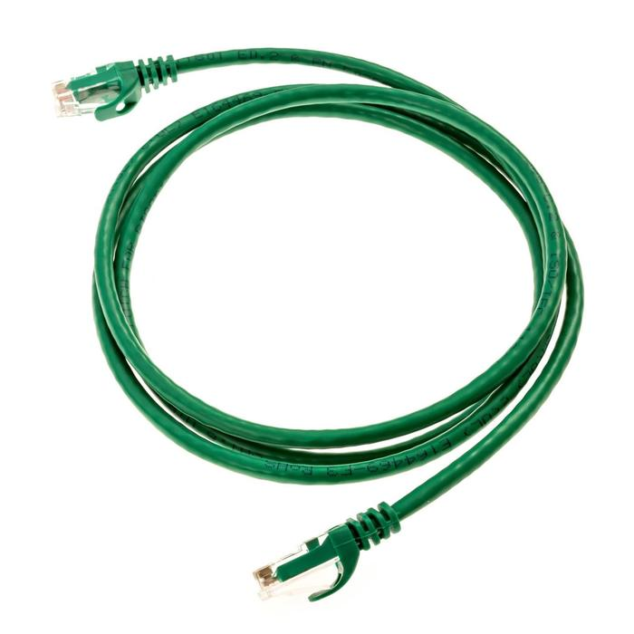


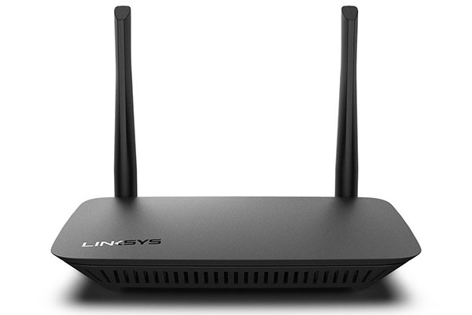






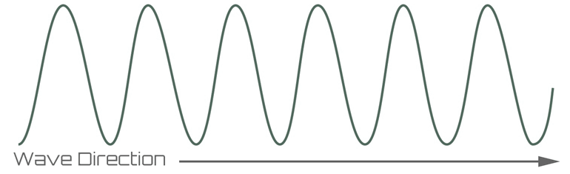


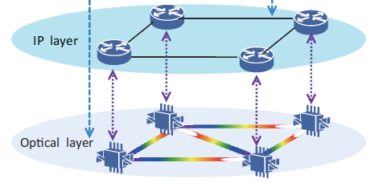


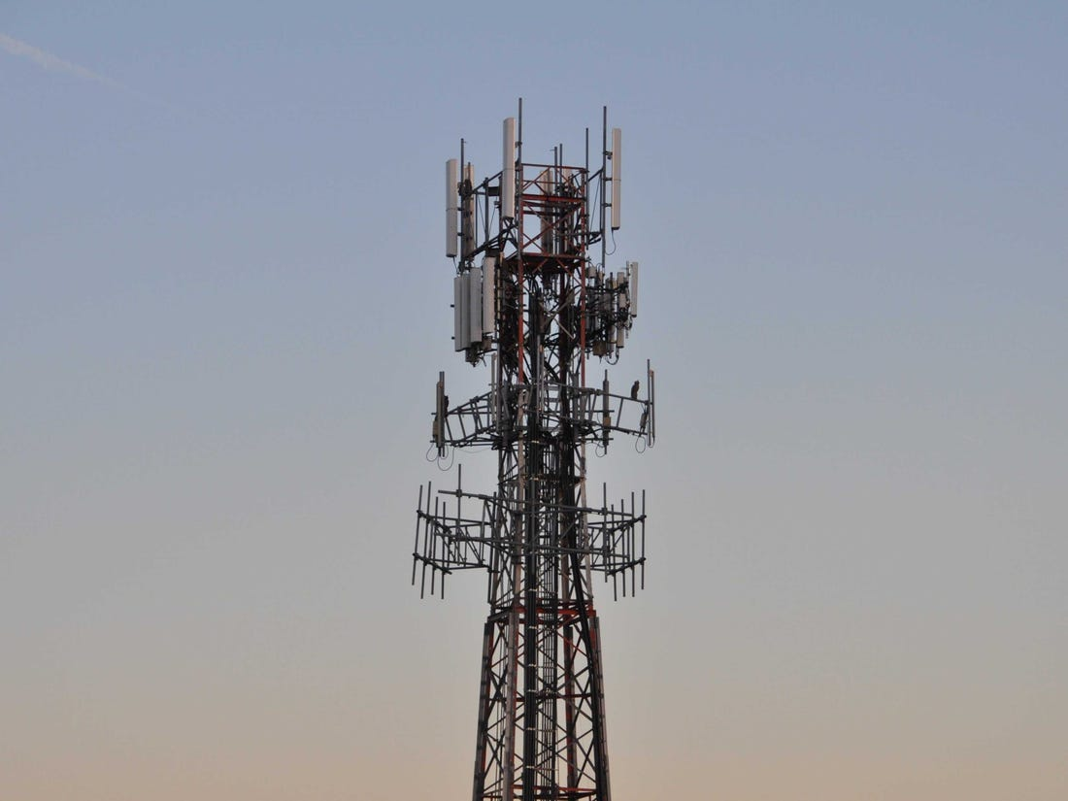







Network Edge
Network Access
Network Core
Home
Broadband Network
Coaxial
Fiber optic
Aggregation Switch
Edge
Router
802.11 (Wi-Fi)
Backbone Network
Mobile
Cellular Network
3GPP 4G (LTE)
Serving Gateway
Packet
Gateway
Data Center
Tier 1/2/3 Service Provider

Slide 2




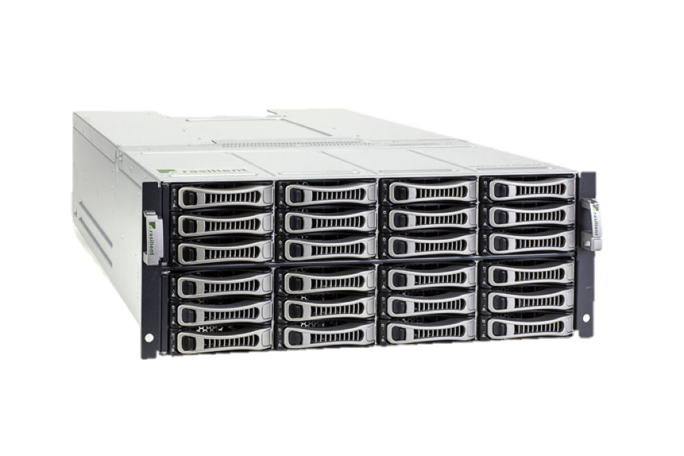
Internet Protocol Stack
5- application: supporting network applications
4- transport: process-process data transfer
3- network: routing of datagrams from source to destination
2- link: data transfer between neighboring network elements
1- physical: bits “on the wire”
5 - Application Layer - HTTPS
Twitter App
Twitter Server
4 - Transport Layer - TCP
iOS
3 - Network Layer - IP
Redhat Linux
2- Link Layer - Ethernet
2- Link Layer - Ethernet
2- Link Layer - Ethernet
2- Link Layer - Ethernet
Switch
Router
802.11 (Wi-Fi)
Fiber Optic
Cat5
Cat5
Dell Server
iPhone XR
1 - Physical Layer
1 - Physical Layer
1 - Physical Layer
1 - Physical Layer

Slide 3




Examples of Applications
Mobile Apps
e-mail
web
instant messaging
remote login
P2P file sharing
multi-user network games
streaming stored video clips
social networks
voice over IP
real-time video conferencing
grid computing
Web Browsers

Slide 4
Application Models
Client/Server Model
Dynamic, mobile clients communicate with relatively static, centralized servers
Peer-to-Peer (P2P) Model
Dynamic, mobile end clients communicate directly with each other
Servers
Clients
P2P Clients

Slide 5

Control Plane and Data Plane
Control Plane – part of application that prepares the data plane
Data Plane – part of application that sends and receives data
DNS and HTTP Example
DNS Server
DNS Request
Where is twitter.com?
DNS Response
At Address 104.244.42.1
HTTP GET Request
Get the twitter.com webpage
HTTP Response
Here is the webpage contents
Twitter Server

Slide 6
DNS (Domain Name System)

Slide 7
DNS: Domain Name System
People: many identifiers:
SSN, name, passport #
Internet hosts, routers:
IP address (32 bit) - used for addressing datagrams
“name”, e.g., ww.yahoo.com - used by humans
Q: map between IP addresses and name ?
Domain Name System:
distributed database implemented in hierarchy of many name servers
application-layer protocol host, routers, name servers to communicate to resolve names (address/name translation)
note: core Internet function, implemented as application-layer protocol
complexity at network’s “edge”

Slide 8
DNS
DNS services
hostname to IP address translation
host aliasing
Canonical, alias names
mail server aliasing
load distribution
replicated Web servers: set of IP addresses for one canonical name
Why not centralize DNS?
single point of failure
traffic volume
distant centralized database
maintenance
doesn’t scale!

Slide 9
Distributed, Hierarchical Database
Root DNS Servers
com DNS servers
org DNS servers
edu DNS servers
google.com
DNS servers
pbs.org
DNS servers
cooper.edu
DNS servers
nyu.edu
DNS servers
amazon.com
DNS servers
Client wants IP for www.amazon.com; 1st approx:
client queries a root server to find com DNS server
client queries com DNS server to get amazon.com DNS server
client queries amazon.com DNS server to get IP address for www.amazon.com

Slide 10
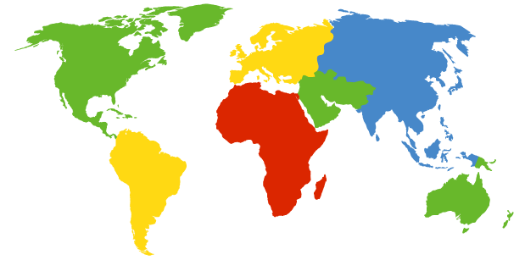
DNS: Root name servers
contacted by local name server that can not resolve name
root name server:
contacts authoritative name server if name mapping not known
gets mapping
returns mapping to local name server
a Verisign, Dulles, VA
c Cogent, Herndon, VA (also LA)
d U Maryland College Park, MD
g US DoD Vienna, VA
h ARL Aberdeen, MD
j Verisign, ( 21 locations)
k RIPE London (also 16 other locations)
i Autonomica, Stockholm (plus 28 other locations)
e NASA Mt View, CA
f Internet Software C. Palo Alto, CA (and 36 other locations)
m WIDE Tokyo (also Seoul, Paris, SF)
13 root name servers worldwide
b USC-ISI Marina del Rey, CA
l ICANN Los Angeles, CA

Slide 11
TLD and Authoritative Servers
Top-level domain (TLD) servers:
responsible for com, org, net, edu, etc, and all top-level country domains uk, fr, ca, jp.
Network Solutions maintains servers for com TLD
Educause for edu TLD
Authoritative DNS servers:
organization’s DNS servers, providing authoritative hostname to IP mappings for organization’s servers (e.g., Web, mail).
can be maintained by organization or service provider

Slide 12
Local Name Server
does not strictly belong to hierarchy
each ISP (residential ISP, company, university) has one.
also called “default name server”
when host makes DNS query, query is sent to its local DNS server
acts as proxy, forwards query into hierarchy

Slide 13

DNS name resolution example
root DNS server
2
Host at cis.poly.edu wants IP address for gaia.cs.umass.edu
3
TLD DNS server
4
5
iterated query:
contacted server replies with name of server to contact
“I don’t know this name, but ask this server”
local DNS server
dns.poly.edu
7
6
1
8
authoritative DNS server
dns.cs.umass.edu
requesting host
cis.poly.edu
gaia.cs.umass.edu

Slide 14
DNS name resolution example
root DNS server
recursive query:
puts burden of name resolution on contacted name server
heavy load?
2
3
7
6
TLD DNS server
local DNS server
dns.cooper.edu
5
4
1
8
authoritative DNS server
dns.cs.umass.edu
requesting host
ice04.ee.cooper.edu
gaia.cs.umass.edu

Slide 15
DNS: caching and updating records
once (any) name server learns mapping, it caches mapping
cache entries timeout (disappear) after some time
TLD servers typically cached in local name servers
Thus root name servers not often visited
update/notify mechanisms under design by IETF
RFC 2136
http://www.ietf.org/html.charters/dnsind-charter.html

Slide 16
DNS records
DNS: distributed db storing resource records (RR)
RR format: (name, value, type, ttl)
Type=A
name is hostname
value is IP address
Type=CNAME
name is alias name for some “canonical” (the real) name
www.ibm.com is really
servereast.backup2.ibm.com
value is canonical name
Type=NS
name is domain (e.g. foo.com)
value is hostname of authoritative name server for this domain
Type=MX
value is name of mailserver associated with name

Slide 17
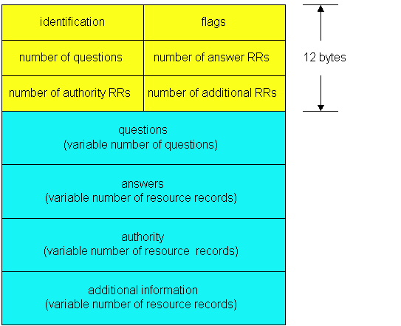
DNS protocol, messages
DNS protocol : query and reply messages, both with same message format
msg header
identification: 16 bit # for query, reply to query uses same #
flags:
query or reply
recursion desired
recursion available
reply is authoritative

Slide 18
DNS protocol, messages
Name, type fields
for a query
RRs in response
to query
records for
authoritative servers
additional “helpful”
info that may be used

Slide 19
Inserting records into DNS
example: new startup “Network Utopia”
register name networkuptopia.com at DNS registrar (e.g., Network Solutions)
provide names, IP addresses of authoritative name server (primary and secondary)
registrar inserts two RRs into com TLD server:
(networkutopia.com, dns1.networkutopia.com, NS)
(dns1.networkutopia.com, 212.212.212.1, A)
create authoritative server Type A record for www.networkuptopia.com; Type MX record for networkutopia.com
How do people get IP address of your Web site?

Slide 20
HTTP (Hyper Text Transfer Protocol)

Slide 21
Web and HTTP
First some jargon
Web page consists of objects
Object can be HTML file, JPEG image, Java applet, audio file,…
Web page consists of base HTML-file which includes several referenced objects
Each object is addressable by a URL
Example URL:
www.cooper.edu/eeDept/tobyAfricaShirt.gif
host name
path name

Slide 22

HTTP overview
HTTP: hypertext transfer protocol
Web’s application layer protocol
client/server model
client: browser that requests, receives, “displays” Web objects
server: Web server sends objects in response to requests
HTTP request
PC running
Explorer
HTTP response
HTTP request
Server
running
Apache Web
server
HTTP response
Mac running
Navigator

Slide 23
HTTP overview (continued)
Uses TCP:
client initiates TCP connection (creates socket) to server, port 80
server accepts TCP connection from client
HTTP messages (application-layer protocol messages) exchanged between browser (HTTP client) and Web server (HTTP server)
TCP connection closed
HTTP is “stateless”
server maintains no information about past client requests
aside
Protocols that maintain “state” are complex!
past history (state) must be maintained
if server/client crashes, their views of “state” may be inconsistent, must be reconciled

Slide 24
HTTP connections
Nonpersistent HTTP
At most one object is sent over a TCP connection.
Persistent HTTP
Multiple objects can be sent over single TCP connection between client and server.

Slide 25
Nonpersistent HTTP
(contains text,
references to 10
jpeg images)
Suppose user enters URL www.cooper.edu/eeDept/freddy/BLAH.html
1a. HTTP client initiates TCP connection to HTTP server (process) at www.cooper.edu on port 80
1b. HTTP server at host www.someSchool.edu waiting for TCP connection at port 80. “accepts” connection, notifying client
2. HTTP client sends HTTP request message (containing URL) into TCP connection socket. Message indicates that client wants object eeDept/freddy/BLAH.html
3. HTTP server receives request message, forms response message containing requested object, and sends message into its socket
time

Slide 26
Nonpersistent HTTP (cont.)
4. HTTP server closes TCP connection.
5. HTTP client receives response message containing html file, displays html. Parsing html file, finds 10 referenced jpeg objects
time
6. Steps 1-5 repeated for each of 10 jpeg objects

Slide 27
Non-Persistent HTTP: Response time
Definition of RTT: time for a small packet to travel from client to server and back.
Response time:
one RTT to initiate TCP connection
one RTT for HTTP request and first few bytes of HTTP response to return
file transmission time
total = 2RTT+transmit time
initiate TCP
connection
RTT
request
file
RTT
time to
transmit
file
file
received
time
time

Slide 28
Persistent HTTP
Nonpersistent HTTP issues:
requires 2 RTTs per object
OS overhead for each TCP connection
browsers often open parallel TCP connections to fetch referenced objects
Persistent HTTP
server leaves connection open after sending response
subsequent HTTP messages between same client/server sent over open connection
client sends requests as soon as it encounters a referenced object
as little as one RTT for all the referenced objects

Slide 29
HTTP request message
two types of HTTP messages: request, response
HTTP request message:
ASCII (human-readable format)
request line
(GET, POST,
HEAD commands)
GET /somedir/page.html HTTP/1.1
Host: www.someschool.edu
User-agent: Mozilla/4.0
Connection: close
Accept-language:fr
(extra carriage return, line feed)
header
lines
Carriage return,
line feed
indicates end
of message

Slide 30
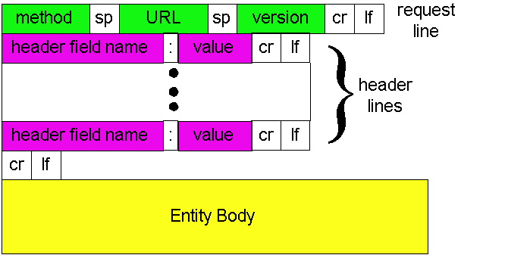
HTTP request message: general format

Slide 31
Uploading form input
Post method:
Web page often includes form input
Input is uploaded to server in entity body
URL method:
Uses GET method
Input is uploaded in URL field of request line:
www.somesite.com/animalsearch?monkeys&banana

Slide 32
Method types
HTTP/1.0
GET
POST
HEAD
asks server to leave requested object out of response
HTTP/1.1
GET, POST, HEAD
PUT
uploads file in entity body to path specified in URL field
DELETE
deletes file specified in the URL field

Slide 33
HTTP response message
status line
(protocol
status code
status phrase)
HTTP/1.1 200 OK
Connection close
Date: Thu, 06 Aug 1998 12:00:15 GMT
Server: Apache/1.3.0 (Unix)
Last-Modified: Mon, 22 Jun 1998 …...
Content-Length: 6821
Content-Type: text/html
data data data data data ...
header
lines
data, e.g.,
requested
HTML file

Slide 34
HTTP response status codes
In first line in server->client response message.
A few sample codes:
200 OK
request succeeded, requested object later in this message
301 Moved Permanently
requested object moved, new location specified later in this message (Location:)
400 Bad Request
request message not understood by server
404 Not Found
requested document not found on this server
505 HTTP Version Not Supported

Slide 35
Trying out HTTP (client side) for yourself
1. Telnet to your favorite Web server:
telnet cis.poly.edu 80
Opens TCP connection to port 80
(default HTTP server port) at cis.poly.edu.
Anything typed in sent
to port 80 at cis.poly.edu
2. Type in a GET HTTP request:
GET /~ross/ HTTP/1.1
Host: cis.poly.edu
By typing this in (hit carriage
return twice), you send
this minimal (but complete)
GET request to HTTP server
3. Look at response message sent by HTTP server!

Slide 36
User-server state: cookies
Example:
Susan always access Internet always from PC
visits specific e-commerce site for first time
when initial HTTP requests arrives at site, site creates:
unique ID
entry in backend database for ID
Many major Web sites use cookies
Four components:
1) cookie header line of HTTP response message
2) cookie header line in HTTP request message
3) cookie file kept on user’s host, managed by user’s browser
4) back-end database at Web site

Slide 37
Cookies: keeping “state” (cont.)
client
server
ebay 8734
usual http request msg
Amazon server
creates ID
1678 for user
cookie file
usual http response
Set-cookie: 1678
create
entry
ebay 8734
amazon 1678
usual http request msg
cookie: 1678
cookie-
specific
action
access
one week later:
usual http response msg
backend
database
access
ebay 8734
amazon 1678
usual http request msg
cookie: 1678
cookie-
spectific
action
usual http response msg

Slide 38
Cookies (continued)
aside
What cookies can bring:
authorization
shopping carts
recommendations
user session state (Web e-mail)
Cookies and privacy:
cookies permit sites to learn a lot about you
you may supply name and e-mail to sites
How to keep “state”:
protocol endpoints: maintain state at sender/receiver over multiple transactions
cookies: http messages carry state

Slide 39



Web caches (proxy server)
Goal: satisfy client request without involving origin server
user sets browser: Web accesses via cache
browser sends all HTTP requests to cache
object in cache: cache returns object
else cache requests object from origin server, then returns object to client
origin
server
Proxy
server
HTTP request
HTTP request
client
HTTP response
HTTP response
HTTP request
HTTP response
client
origin
server

Slide 40
More about Web caching
cache acts as both client and server
typically cache is installed by ISP (university, company, residential ISP)
Why Web caching?
reduce response time for client request
reduce traffic on an institution’s access link.
Internet dense with caches: enables “poor” content providers to effectively deliver content (but so does P2P file sharing)

Slide 41
Caching example
origin
servers
Assumptions
average object size = 1,000,000 bits
avg. request rate from institution’s browsers to origin servers = 15/sec
delay from institutional router to any origin server and back to router = 2 sec
Consequences
utilization on LAN = 15%
utilization on access link = 100%
total delay = Internet delay + access delay + LAN delay
= 2 sec + minutes + milliseconds
public
Internet
15 Mbps
access link
institutional
network
100 Mbps LAN
institutional
cache

Slide 42
Caching example (cont)
origin
servers
possible solution
increase bandwidth of access link to, say, 100 Mbps
consequence
utilization on LAN = 15%
utilization on access link = 15%
Total delay = Internet delay + access delay + LAN delay
= 2 sec + msecs + msecs
often a costly upgrade
public
Internet
100 Mbps
access link
institutional
network
100 Mbps LAN
institutional
cache

Slide 43
Caching example (cont)
origin
servers
possible solution: install cache
suppose hit rate is 0.4
consequence
40% requests will be satisfied almost immediately
60% requests satisfied by origin server
utilization of access link reduced to 60%, resulting in negligible delays (say 10 msec)
total avg delay = Internet delay + access delay + LAN delay = .6*(2.01) secs + .4*milliseconds < 1.4 secs
public
Internet
15 Mbps
access link
institutional
network
100 Mbps LAN
institutional
cache

Slide 44
Conditional GET
cache
server
Goal: don’t send object if cache has up-to-date cached version
cache: specify date of cached copy in HTTP request
If-modified-since: <date>
server: response contains no object if cached copy is up-to-date:
HTTP/1.0 304 Not Modified
HTTP request msg
If-modified-since: <date>
object
not
modified
HTTP response
HTTP/1.0
304 Not Modified
HTTP request msg
If-modified-since: <date>
object
modified
HTTP response
HTTP/1.0 200 OK
<data>

